Slide 1
With Statutory curriculum provision comes a need for a coherent yet versatile means of ongoing assessment which will chart pupil progress and provide a simple tool for continuous assessment across KS2 as well as transfer information about Year 6 pupils to pass on to secondary schools.

Slide 2
As part of a recent DfE funded Languages Support Programme, a group of Westdene TSA partner schools focused on developing user-friendly assessment tools for primary languages.
The group, comprising four primary schools and two secondary schools, used both local and national frameworks (the Languages Ladder) as a point of reference.
They trialled the frameworks shown today produced the support materials for primary and secondary schools which feature of the TSA website.

Slide 3
http://www.thelifecloud.net/schools/WTSA/spaces/LanguageSupportProgramme/

Slide 4
What is the purpose of assessment?
What should good assessment provide for pupils and teachers?

Slide 5
Assessment should provide:
a shared language for discussing progress and improvement
be dependable
be manageable
be transferable from teacher to teacher and KS to KS
be meaningful for teachers and pupils.

Slide 6
Language Learning Record
Pupil Progress sheets
Skills and Topic grids
Suggested Level descriptors
Transition Information Sheet

Slide 7
A framework for teachers for assessing language learning in KS2 as part of everyday learning.
The statements describing achievement in Oracy and Literacy, can be used formatively so that pupils:
• know where they are in their learning at any given time
• understand and agree their next steps
• understand how to get there.
The statements can also be used summatively:
• to provide information for completing end of year reports
• to pass on to the next teacher
• to provide information to pass on to secondary schools at the end of Yr6

Slide 8
Order the cards by
skill area and progression

Slide 9
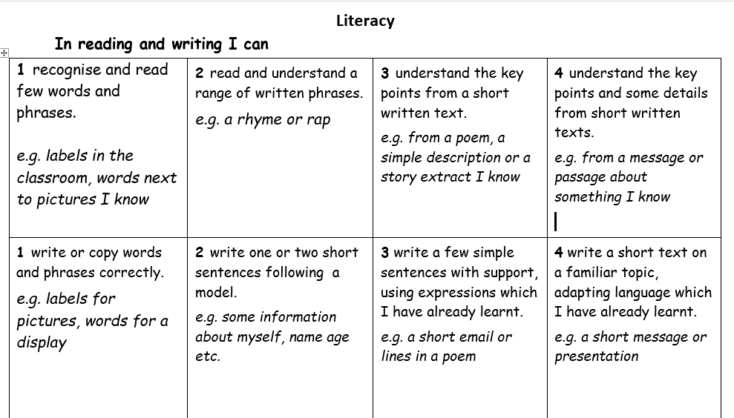

Slide 11
On Pg1, pupils should insert language themes in the appropriate topic box
One Pg2, in the skills section, pupils can either tick or date boxes, or describe the activity where they used this skill
On Pg 2, pupils can date, tick or colour the oracy and literacy boxes when they have achieved that level. To be comfortably at a level, pupils should be able to demonstrate its characteristics over time and in different contexts.
From Pg 3 onwards, pupils can build a portfolio of their best work, updating it as they progress.

Slide 12
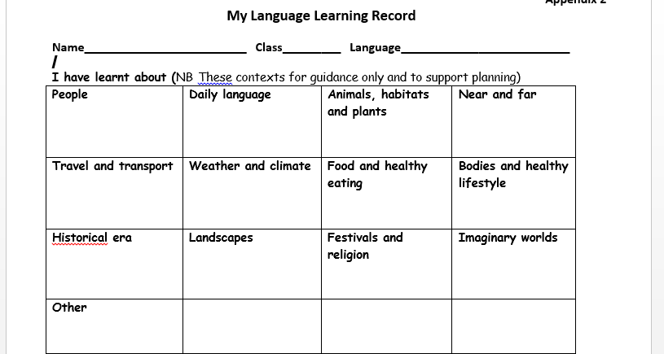

Slide 13
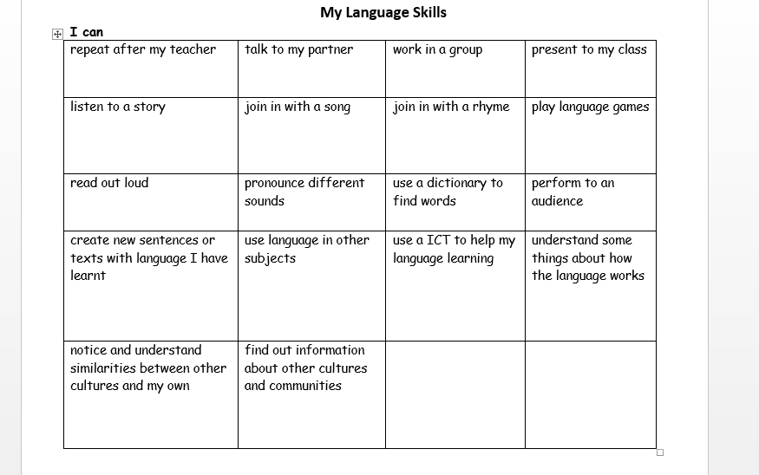

Slide 14
Ways to assess in the classroom
through observation in class
recording speaking (apps, mics etc)
recording outcomes (apps, blogs, photos, presentations, Storybird, Popplet, Wallwisher, Socrative)
reviewing of pupil work - marking and feedback
informal assessment of pupils working (pairs, groups and individual activities)
To support this, teachers can use AFL strategies including:
• peer and self assessment
• two stars and a wish method
• thumbs up thumbs down
• traffic lighting
• mini white board activities
• target setting

Slide 15
What have I found in practice?
Easy to follow
Ready resource
Allows for flexibility
Feeds into NC and KS3
Will need refining as time goes on

